Slide 1
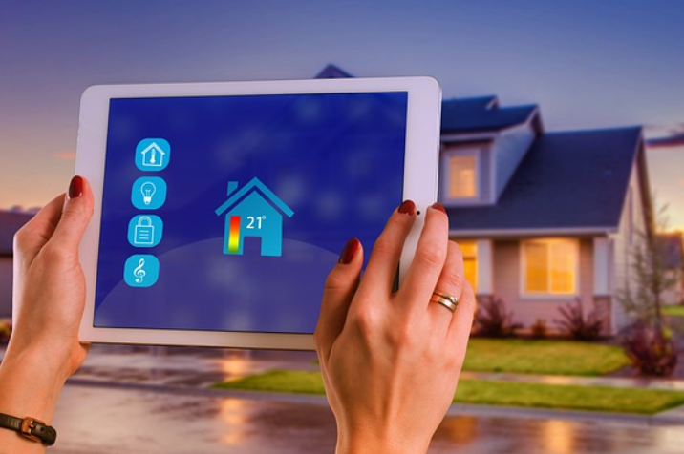
SMART HOME PROJECT PRESENTATION
Notes:
Delete this slide when you finish preparing the other slides.

Slide 2

OVERVIEW OF OUR SMART HOME SYSTEM
A smart home system represents a practical and innovative approach to modern living, incorporating advanced features tailored to enhance both convenience and security. This system includes the ability to automatically control a door using a servo motor and an infrared sensor, ensuring secure access to your home. It also integrates various sensors such as IR, PIR, and flame sensors to detect movement, monitor for fire hazards, and prevent unauthorized access. The system can be seamlessly managed through a dedicated mobile application built with Flutter, allowing users to monitor and control their home environment remotely. This introduction sets the stage for a detailed exploration of the project's components and functionalities.

Slide 3
PROJECT COMPONENTS
ESP32 Dev Kit
Servo Motor
Sensors:
Ultra sonic
Falme sensor
Dht11
Rain drop
ldr
Keypad Module
LCD Screen
Project Maquette

Slide 4
ESP32 DEV KIT
Description:
Dual-core processor running at 240 MHz.
Supports Wi-Fi and Bluetooth connectivity.
Features:
Handles multiple components.
Easy to program using Arduino IDE or Platform IO.
Importance:
Centralized control of the system with internet connectivity for remote control.

Slide 5
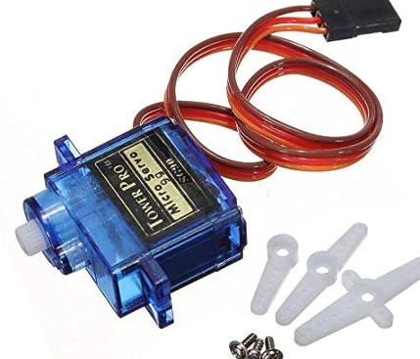
SERVO MOTOR
Description:
Provides precise angle control.
Ideal for applications requiring specific movements.
Connection:
Connected to ESP32 to control door opening and closing.
Importance:
Controls the precise opening and closing of smart doors.

Slide 6
SENSORS
Ultrasonic Sensor:
Use: Measures distance to an object using ultrasonic waves.
Connection: Provides distance measurements to the microcontroller.
Flame Sensor:
Use: Detects the presence of flames.
Connection: Sends alerts when flames are detected.
DHT11:
Use: Measures temperature and humidity.
Connection: Provides temperature and humidity data to the microcontroller.
Rain Drop Sensor:
Use: Detects the presence of water or rain.
Connection: Sends signals when water or rain is detected.
LDR Sensor:
Use: Detects the presence of light and measures light intensity.
Connection: Sends signals by varying resistance depending on the light level;
lower resistance in bright light, higher resistance in darkness.

Slide 7
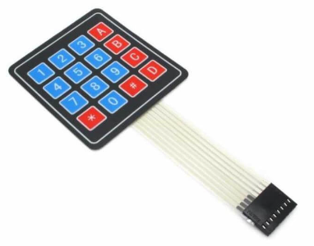
KEYPAD MODULE
Description:
Includes a set of buttons for entering passwords or commands.
Connection:
Connected to ESP32 for system control.
Importance:
Allows users to input passwords or commands for system control.

Slide 8
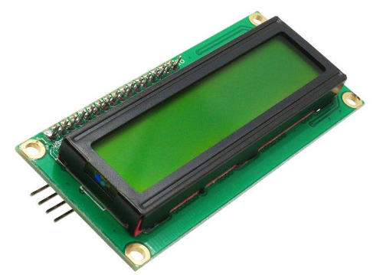
LCD SCREEN
Description:
Displays live data from sensors.
Connection:
Connected to ESP32 to show information.
Importance:
Provides real-time information on system status and sensor data.

Slide 9
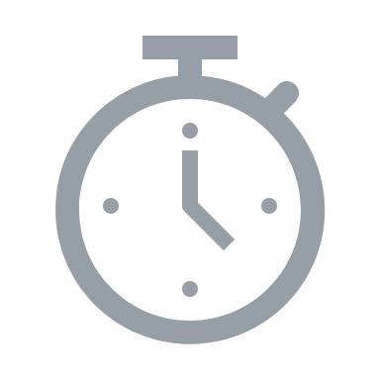
FRAMEWORKS USED
Arduino IDE:
Purpose: Programming the ESP32 using C++.
Features: User-friendly interface for writing and uploading code.
Flutter:
Purpose: Developing cross-platform mobile applications.
Features: Provides a rich set of widgets and tools for building interactive and responsive user interfaces.
MQTT Broker:
Purpose: Messaging protocol for lightweight communication between devices.
Features: Facilitates data exchange between ESP32, database, and applications.

Slide 10
PLATFORMS USED
Platform IO:
Purpose: Integrated development environment for programming ESP32.
Features: Supports various development boards and provides robust tools for project management and dependencies.
Wokwi:
Purpose: Simulating and designing electronic circuits.
Features: Online tool for creating and testing electronic circuits
GitHub:
Purpose: Hosting and version control for code.
Features: Allows collaborative development, code sharing, and version tracking.

Slide 11
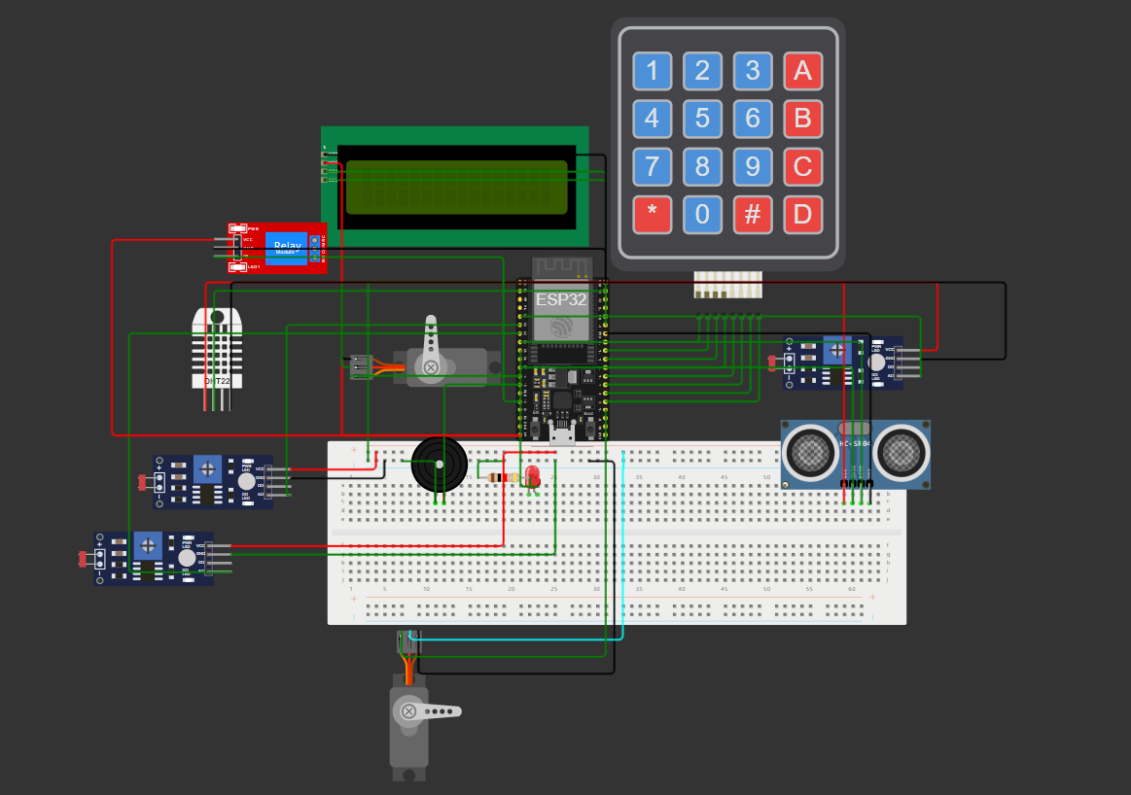
CIRCUIT DIAGRAM

Slide 12
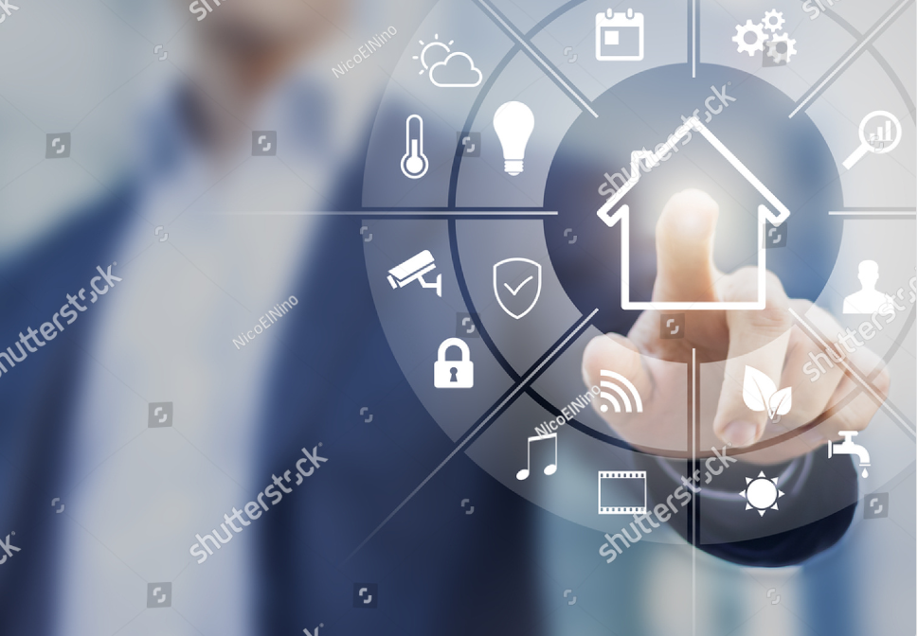
SMART HOME APPLICATION
our Flutter app serves as a comprehensive control center for a smart home,combining the latest technology in IoT with a sleek and efficient mobile interface.

Slide 13
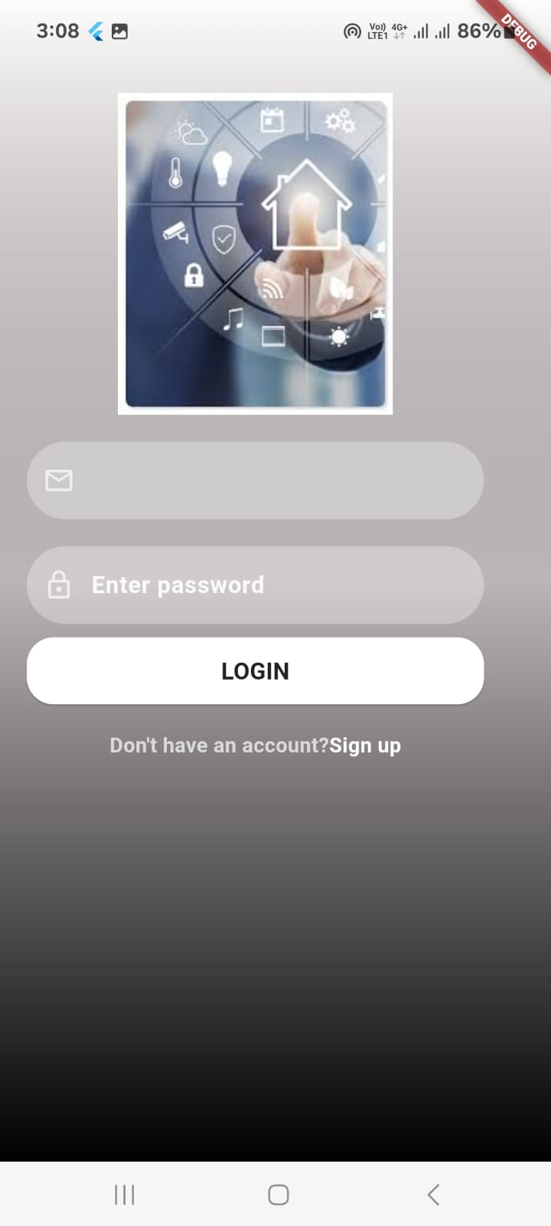
LOG IN SCREEN
Description:
Enables users to access their accounts using their registered credentials.
Core Functions:
Enter email and password.
Log In button.
Technical Details:
Firebase Integration: Validates credentials.
User Interface: Simple layout with clear input fields
and a prominent Log In button

Slide 14
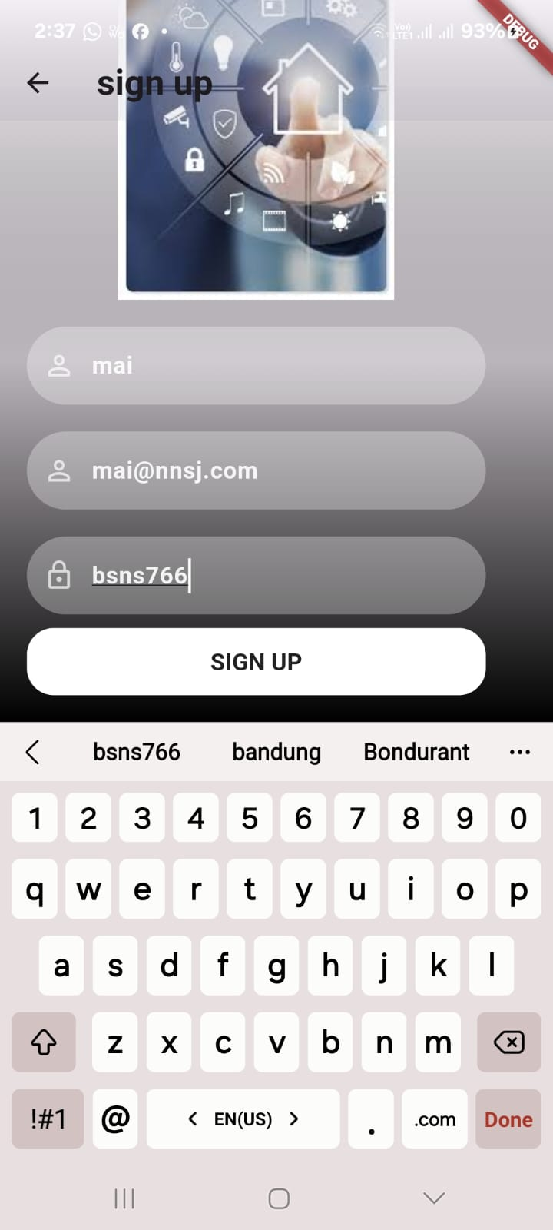
SIGN UP SCREEN
Description: Allows users to create a new account by entering their email and password, with data validation.
Core Functions:
Enter email and password.
Confirm password.
Sign Up button.
Technical Details:
Firebase Integration: Secure data storage and authentication.
User Interface: Simple design with clear input fields and a prominent Sign Up button

Slide 15
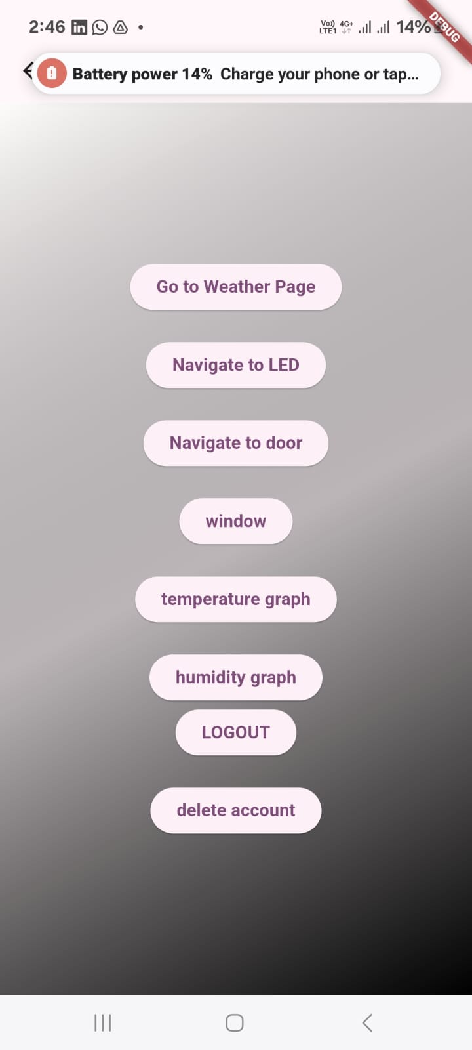
HOME SCREEN
The page contains several buttons, each of which takes you to a specific function within the application.
The buttons include:
Go to Weather Page:A button that takes you to the weather page.Navigate
LED: A button to control the LED lighting.Navigate
door: A button to control the door.
Window:A button to possibly control the window.
Temperature graph: A button to display a temperature graph.
Humidity graph: A button to display a humidity graph.
LOGOUT: A button to log out of the application.
Delete Account: A button to confirm the deletion of the user's account from the application.

Slide 16
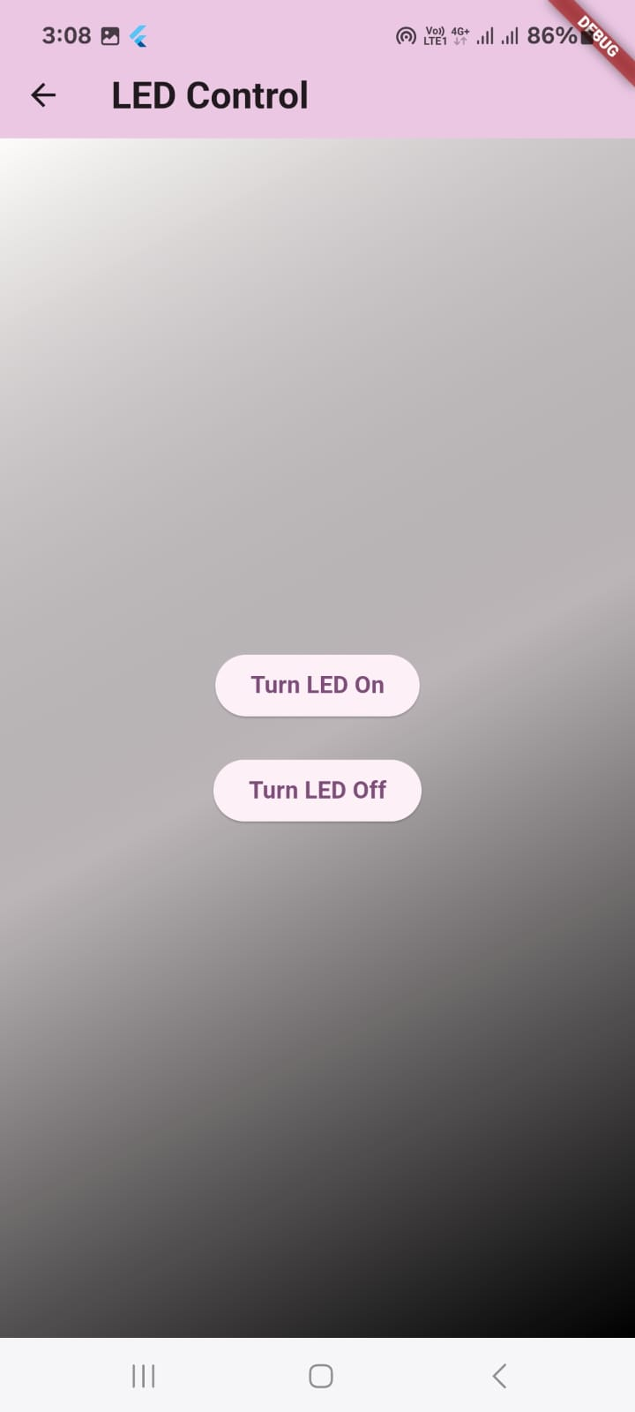
LED CONTROL SCREEN
Purpose: The LED Control Screen allows users to
manage the lighting in their smart home by controlling LEDs.
How It Works:
Users can turn LEDs on or off using toggle buttons on the screen.
The screen communicates with the ESP32 device via MQTT
to send commands for controlling the LEDs.

Slide 17
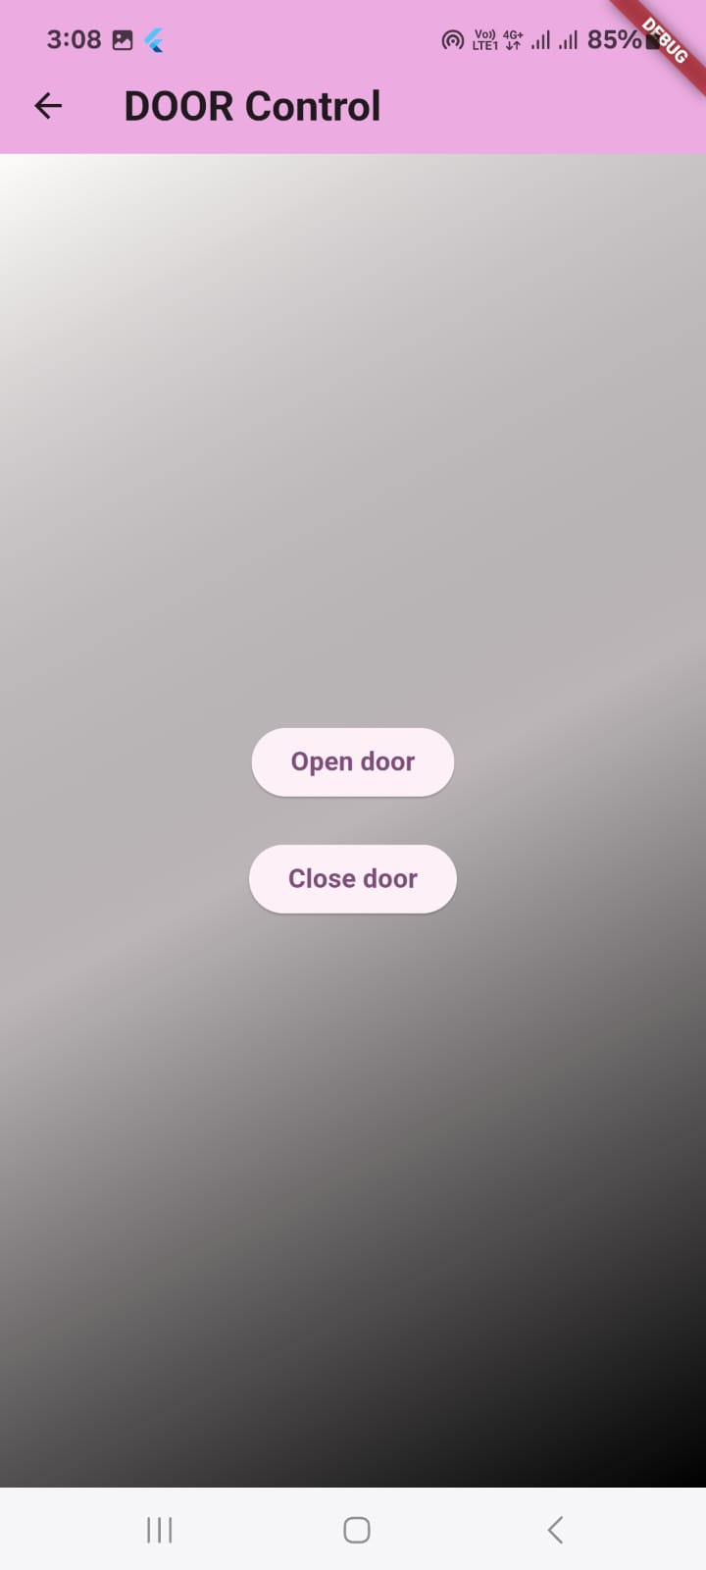
DOOR CONTROL SCREEN
Purpose: This screen enables users to control the smart door system,
allowing them to lock or unlock the door remotely.
How It Works:
The screen features buttons for locking and unlocking the door.
It may also display the current status of the door (e.g., locked or unlocked).
Commands are sent to the ESP32 via MQTT to control
the servo motor responsible for the door mechanism.

Slide 18
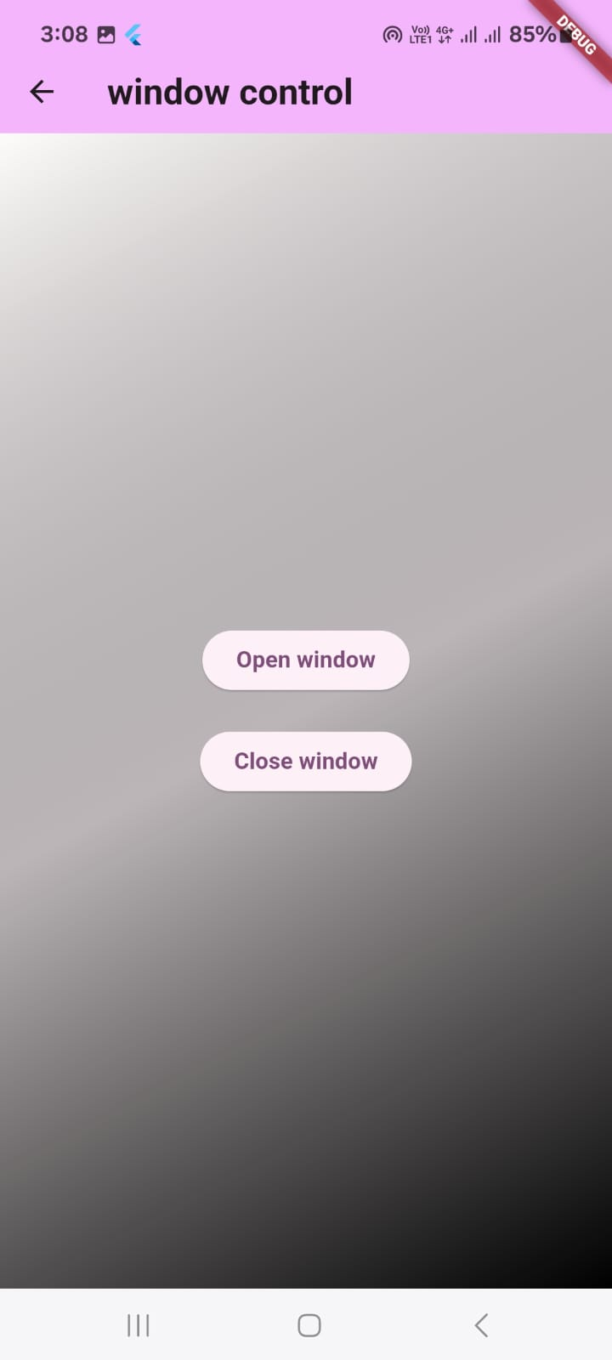
WINDOW CONTROL SCREEN
Purpose: The Window Control Screen is designed to let users
open or close windows in their smart home,
based on environmental conditions or personal preferences.
How It Works:
Users can control the windows through buttons or sliders on the screen.
The app sends commands to the ESP32 via MQTT to control actuators
(e.g., motors) that open or close the windows.

Slide 19
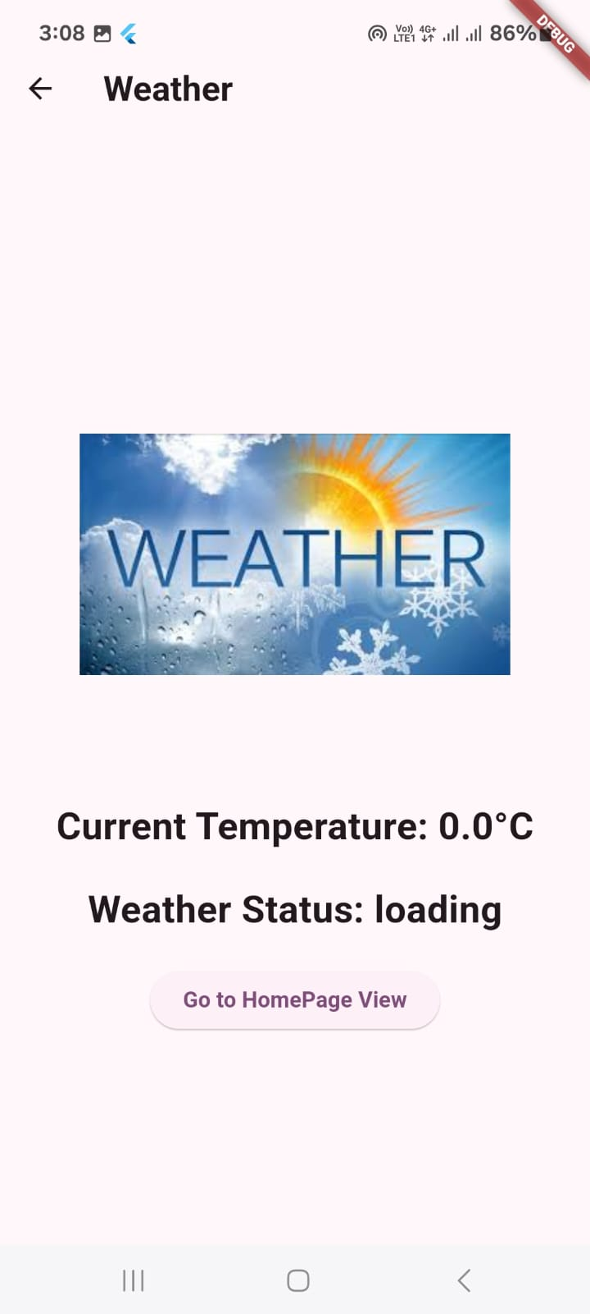
WEATHER SCREEN
Purpose: The Weather Screen provides users with real-time weather information,
helping them make informed decisions about their home environment.
How It Works:
The screen displays data such as temperature and weather status.
The user can view the current weather and adjust
their home environment accordingly.

Slide 20
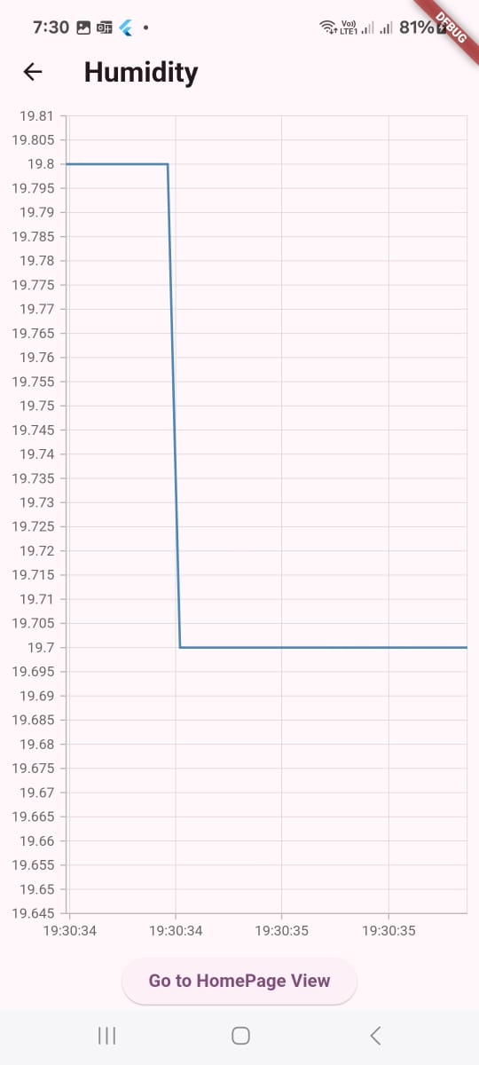
HUMIDITY GRAPH
Purpose: The Humidity Graph screen visualizes humidity levels over time, helping users track trends and manage their environment effectively.
How It Works:
Displays a graph of humidity data over time.
Users can interact with the graph to explore trends and details.
Assists in making informed decisions about home humidity control.

Slide 21
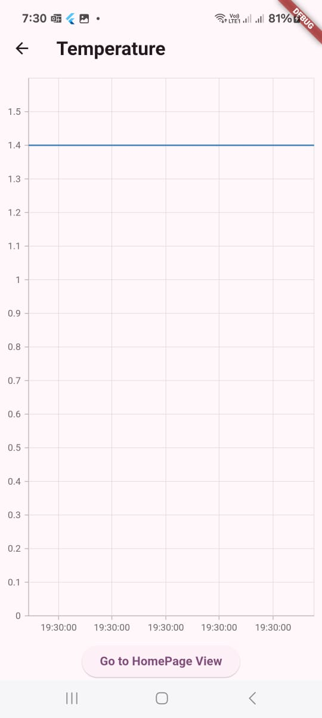
TEMPERATURE GRAPH
Purpose: The Temperature Graph screen provides users with a visual representation of temperature changes over time, helping them monitor and adjust their environment accordingly.
How It Works:
Displays a graph showing temperature variations over a specified period.
Users can interact with the graph to view detailed information about specific time points.
Helps users track temperature trends and make informed decisions about heating or cooling needs

Slide 22
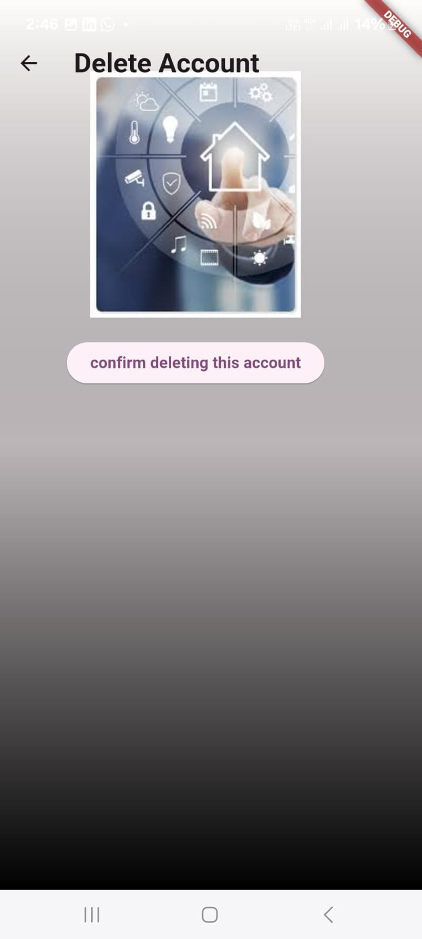
DELETE ACCOUNT
A screen that confirms the deletion of the user's account
to permanently remove their data from the application.

Slide 23
TEAM
Gehad yousri 22011437
Shrouk tarek 22010350
Basmala tharwat 22010069
Raneem mostafa 22011576
Mai Mahmoud 22010401

